Slide 1
Computer Viewing
Matt Evett
Dept. Computer Science
Eastern Michigan University
E. Angel and D. Shreiner: Interactive Computer Graphics 6E © Addison-Wesley 2012

Slide 2
Objectives
Introduce the mathematics of projection
Introduce WebGL viewing functions in MV.js
Look at alternate viewing APIs
Angel and Shreiner: Interactive Computer Graphics 7E © Addison-Wesley 2015

Slide 3
From the Beginning
In the beginning:
  fixed function pipeline
  Model-View and Projection Transformation
  Predefined frames: model, object, camera, clip, ndc, window
After deprecation
  pipeline with programmable shaders
  no transformations
  clip, ndc window frames
MV.js reintroduces original capabilities
Angel and Shreiner: Interactive Computer Graphics 7E © Addison-Wesley 2015

Slide 4
Computer Viewing
There are three aspects of the viewing process, all of which are implemented in the pipeline,
  Positioning the camera
    Setting the model-view matrix
  Selecting a lens
    Setting the projection matrix
  Clipping
    Setting the view volume
E. Angel and D. Shreiner: Interactive Computer Graphics 6E © Addison-Wesley 2012

Slide 5
The WebGL Camera
In WebGL, initially the object and camera frames are the same
  Default model-view matrix is an identity
The camera is located at origin and points in the negative z direction
WebGL also specifies a default view volume that is a cube with sides of length 2 centered at the origin
  Default projection matrix is an identity
Angel and Shreiner: Interactive Computer Graphics 7E © Addison-Wesley 2015

Slide 6
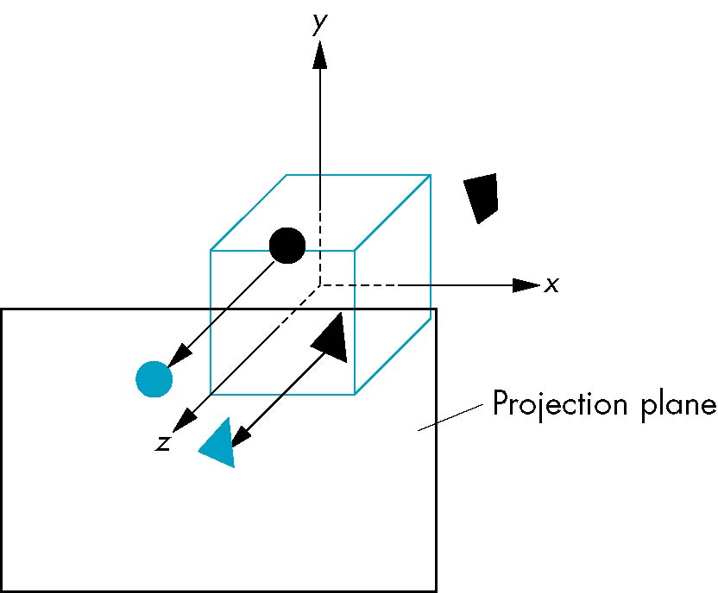
Default Projection
Default projection is orthogonal
clipped out
2
z=0
E. Angel and D. Shreiner: Interactive Computer Graphics 6E © Addison-Wesley 2012

Slide 7
Moving the Camera Frame
If we want to visualize object with both positive and negative z values we can either
  Move the camera in the positive z direction
    Translate the camera frame
  Move the objects in the negative z direction
    Translate the world frame
Both of these views are equivalent and are determined by the model-view matrix
  Want a translation (translate(0.0,0.0,-d);)
  d > 0
E. Angel and D. Shreiner: Interactive Computer Graphics 6E © Addison-Wesley 2012

Slide 8
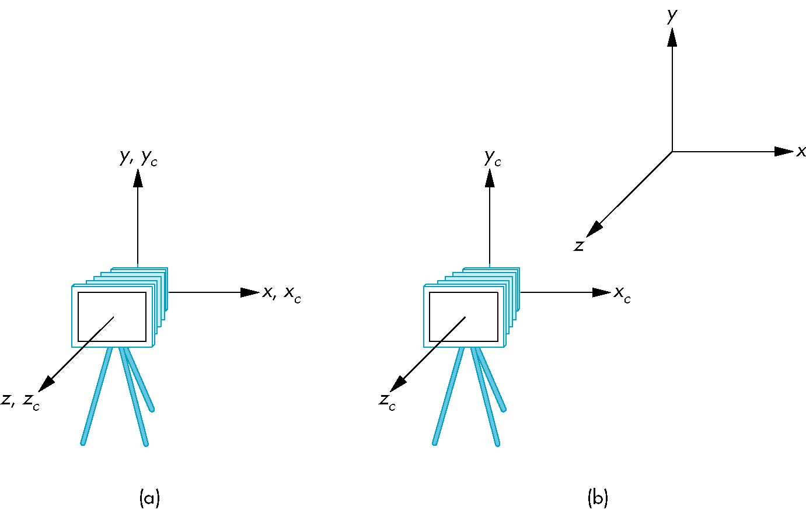
Moving Camera back from Origin
frames after translation by –d
d > 0
default frames
E. Angel and D. Shreiner: Interactive Computer Graphics 6E © Addison-Wesley 2012

Slide 9
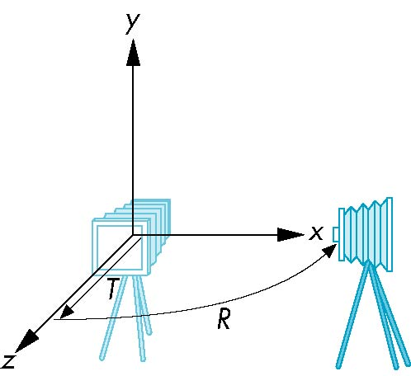
Moving the Camera
We can move the camera to any desired position by a sequence of rotations and translations
Example: side view
  Rotate the camera
  Move it away from origin
  Model-view matrix C = TR
E. Angel and D. Shreiner: Interactive Computer Graphics 6E © Addison-Wesley 2012

Slide 10
WebGL code
Remember that last transformation specified is first to be applied
// Using MV.js
var t = translate (0.0, 0.0, -d);
var ry = rotateY(90.0);
var m = mult(t, ry);
or
var m = mult(translate (0.0, 0.0, -d),
rotateY(90.0););
Angel and Shreiner: Interactive Computer Graphics 7E © Addison-Wesley 2015

Slide 11
The lookAt Function
The GLU library contained the function gluLookAt to form the required modelview matrix through a simple interface
Note the need for setting an up direction
Replaced by lookAt() in MV.js
  Can concatenate with modeling transformations
Example: isometric view of cube aligned with axes
var eye = vec3(1.0, 1.0, 1.0);
var at = vec3(0.0, 0.0, 0.0);
var up = vec3(0.0, 1.0, 0.0);
var mv = LookAt(eye, at, up);
Angel and Shreiner: Interactive Computer Graphics 7E © Addison-Wesley 2015

Slide 12
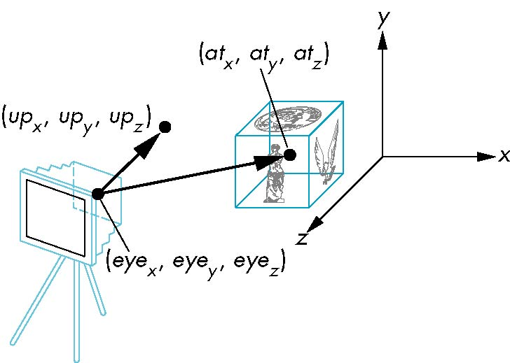
lookAt
LookAt(eye, at, up)
Angel and Shreiner: Interactive Computer Graphics 7E © Addison-Wesley 2015

Slide 13
Other Viewing APIs
The LookAt function is only one possible API for positioning the camera
Others include
  View reference point, view plane normal, view up (PHIGS, GKS-3D)
  Yaw, pitch, roll
  Elevation, azimuth, twist
  Direction angles
E. Angel and D. Shreiner: Interactive Computer Graphics 6E © Addison-Wesley 2012

Slide 14
Projections and Normalization
The default projection in the eye (camera) frame is orthogonal
For points within the default view volume
Most graphics systems use view normalization
  All other views are converted to the default view by transformations that determine the projection matrix
  Allows use of the same pipeline for all views
x_{p} = x
y_{p} = y
z_{p} = 0
E. Angel and D. Shreiner: Interactive Computer Graphics 6E © Addison-Wesley 2012

Slide 15
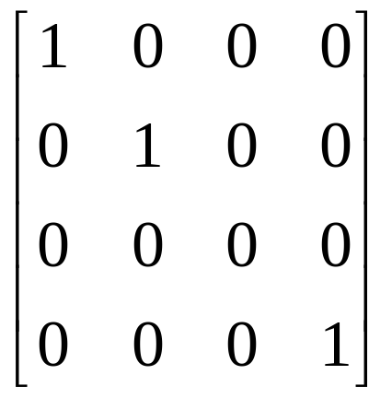
Homogeneous Coordinate Representation
default orthographic projection
x_{p} = x
y_{p} = y
z_{p} = 0
w_{p} = 1
p_{p} = Mp
M =
In practice, we can let M = I and set
the z term to zero later
E. Angel and D. Shreiner: Interactive Computer Graphics 6E © Addison-Wesley 2012

Slide 16
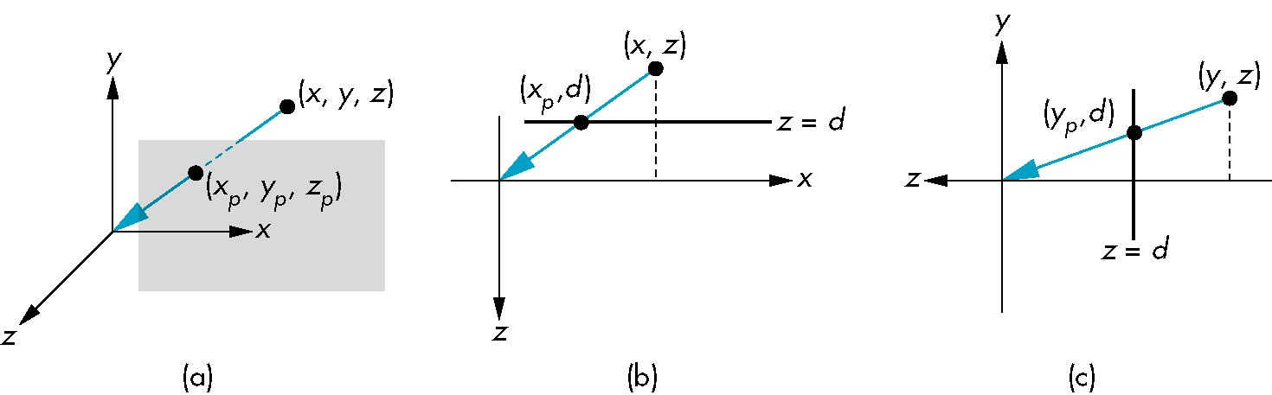
Simple Perspective
Center of projection at the origin
Projection plane z = d, d < 0
E. Angel and D. Shreiner: Interactive Computer Graphics 6E © Addison-Wesley 2012

Slide 17
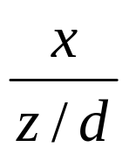
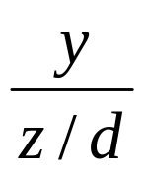
Perspective Equations
Consider top and side views
x_{p} =
y_{p} =
z_{p} = d
E. Angel and D. Shreiner: Interactive Computer Graphics 6E © Addison-Wesley 2012
Notes:
Looking down y-axis from top
Looking down x-axis (from right?)

Slide 18
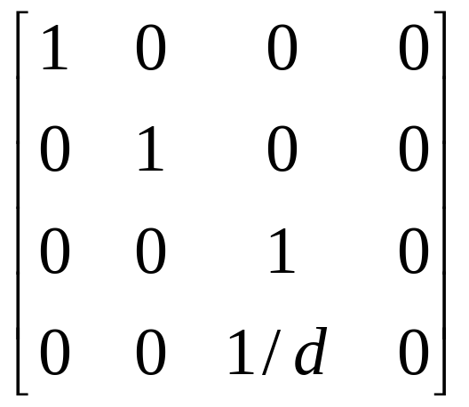
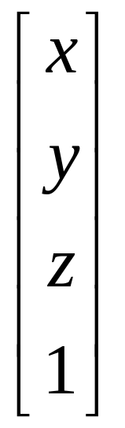
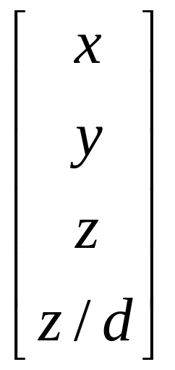
Homogeneous Coordinate Form
consider q = Mp where
M =
q =
⇒ p =
E. Angel and D. Shreiner: Interactive Computer Graphics 6E © Addison-Wesley 2012

Slide 19
Perspective Division
However w ≠ 1, so we must divide by w to return from homogeneous coordinates
This perspective division yields
the desired perspective equations
We will consider the corresponding clipping volume with mat.h functions that are equivalent to deprecated OpenGL functions
x_{p} =
y_{p} =
z_{p} = d
E. Angel and D. Shreiner: Interactive Computer Graphics 6E © Addison-Wesley 2012

Slide 20
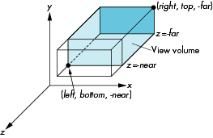
OpenGL Orthogonal Viewing
Ortho(left,right,bottom,top,near,far)
near and far measured from camera
E. Angel and D. Shreiner: Interactive Computer Graphics 6E © Addison-Wesley 2012

Slide 21

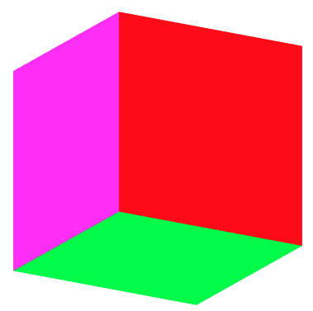
Example Orthogonal View
ortho.html/js
ortho2.html/js
E. Angel and D. Shreiner: Interactive Computer Graphics 6E © Addison-Wesley 2012

Slide 22
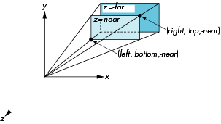
WebGL Perspective
frustum(left,right,bottom,top,near,far)
Angel and Shreiner: Interactive Computer Graphics 7E © Addison-Wesley 2015

Slide 23
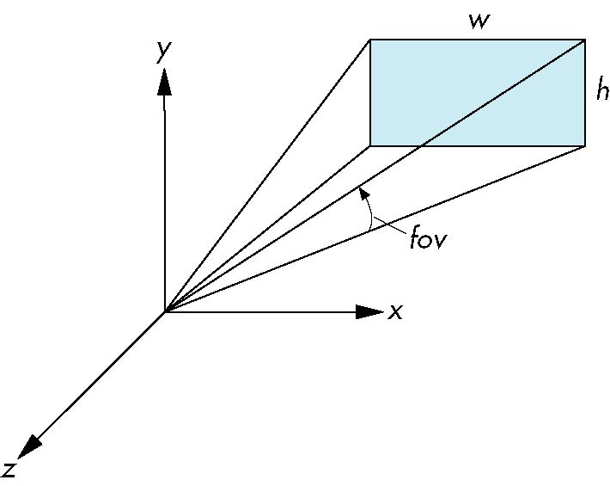
Using Field of View
With Frustum it is often difficult to get the desired view
Perpective(fovy, aspect, near, far) often provides a better interface
front plane
aspect = w/h
E. Angel and D. Shreiner: Interactive Computer Graphics 6E © Addison-Wesley 2012

Slide 24
Using Field of View
With frustum it is often difficult to get the desired view
perpective(fovy, aspect, near, far) often provides a better interface
front plane
aspect = w/h
Angel and Shreiner: Interactive Computer Graphics 7E © Addison-Wesley 2015

Slide 25
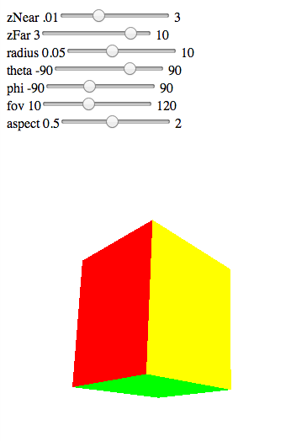

Computing Matrices
Compute in JS file, send to vertex shader with gl.uniformMatrix4fv
Dynamic: update in render() or shader
Angel and Shreiner: Interactive Computer Graphics 7E © Addison-Wesley 2015
Notes:
perspective.html

Slide 26
Computing Matrices
Compute in JS file, send to vertex shader with gl.uniformMatrix4fv
Dynamic: update in render() or shader
Angel and Shreiner: Interactive Computer Graphics 7E © Addison-Wesley 2015
Notes:
perspective2.html

Slide 27
persepctive2.js
var render = function(){
gl.clear( gl.COLOR_BUFFER_BIT | gl.DEPTH_BUFFER_BIT);
eye = vec3(radius*Math.sin(theta)*Math.cos(phi),
radius*Math.sin(theta)*Math.sin(phi), radius*Math.cos(theta));
modelViewMatrix = lookAt(eye, at , up);
projectionMatrix = perspective(fovy, aspect, near, far);
gl.uniformMatrix4fv( modelViewMatrixLoc, false,
flatten(modelViewMatrix) );
gl.uniformMatrix4fv( projectionMatrixLoc, false,
flatten(projectionMatrix) );
gl.drawArrays( gl.TRIANGLES, 0, NumVertices );
requestAnimFrame(render);
}
Angel and Shreiner: Interactive Computer Graphics 7E © Addison-Wesley 2015

Slide 28
vertex shader
Notice order of matrix multiplications!
attribute vec4 vPosition;
attribute vec4 vColor;
varying vec4 fColor;
uniform mat4 modelViewMatrix;
uniform mat4 projectionMatrix;
void main() {
gl_Position = projectionMatrix*modelViewMatrix*vPosition;
fColor = vColor;
}
Angel and Shreiner: Interactive Computer Graphics 7E © Addison-Wesley 2015

Slide 29
Examine hat.html/js
What do the GUI widgets do?
E. Angel and D. Shreiner: Interactive Computer Graphics 6E © Addison-Wesley 2012

Slide 30
Lab 3
See the lab
What’s with all those pushes and pops of matrices?
E. Angel and D. Shreiner: Interactive Computer Graphics 6E © Addison-Wesley 2012
Notes:
file:///Users/matt/Documents/Teaching/Graphics/WebGLPractice/public_html/MattsLab3MatrixTranforms/robot_arm.html

